Slide 1

Records Management for Transfer Students
Made Simple
Presenter:
  Bridget Jones

Slide 2
About Us
We believe that equitable access to government is a right and not a privilege.
Therefore, our mission is to engage the community by providing equitable, open access to school district resources and programs throughout the student lifecycle - beginning with enrollment and continuing post graduation.
      Hosted, SaaS Applications designed exclusively for K-12 School Districts
      19 of the Top 30 School Districts in the US (14 in Virginia)
      Serving >10,000 Schools and Districts (over 11 Millions Students)
      Managing over 26 Million Records
      Over 6,500 Colleges and Universities in our e-Transcript Network
      SOC 2 Type II Certified and FERPA Compliant
Supporting Virginia:

Slide 3

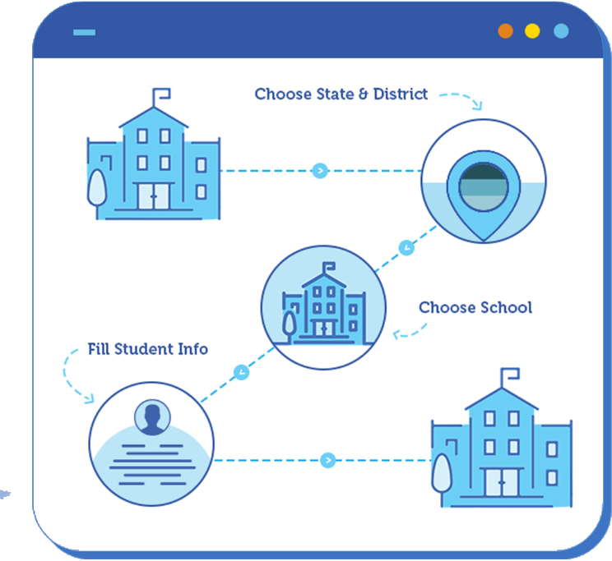
Application Features
      School to School Records Request and Fulfilment
      Self-Services Application for Schools Requesting Records
      User-Friendly Application for School District Employees to Process Requests
      Comprehensive Reporting
      Provides an Audit Trail of all Records Transmittals
      e-Document Delivery Saves time and Money
      Enhanced Security over Manual Process

Slide 4
Districts Benefits
      Unifies and Optimized the Records Transmittal Process across the Entire District
      Automates the Request and Transmittal of Records for the Inter-District and Out of Districts Transfers
      Manages “Whereabouts Unknowns” impacting Graduation Rates
      Handles Priority requests from Alternative Schools
      Manages Special Education Requests (Large Files)
      Insures FERPA Compliance
      Assists with Student Retention and Recruitment
      Provides Critical Data for School Choice

Slide 5


Compliance Benefits
      Identity Protection
      Aging Report
      Release of Directory Information
      Student Consent, force an upload of signed release
      The Four Tests
                What is discussed
                Where the discussion takes place
                Who is listening
                Why the discussion took place

Slide 6
Scenarios
Your school or district office gets an urgent call from a school outside of your state. A family has arrived at their school to enroll their child and they are asking for records to be emailed or faxed to them immediately. What do you do?
Security risk
Liability
FERPA Violation
None of the above

Slide 7
Scenarios
Your school or district office gets an urgent call from a VERIFIED requester outside of your state. A family has arrived at their school to enroll their child and they are asking for records to be faxed to them immediately. They are so lucky! You actually have a free moment to run this information to the fax machine. While you are waiting for the information to go through, you get called away. When you return it has all gone through and it waiting for you on the machine.
Any Issues?
Security risk
Liability
FERPA Violation
None of the above

Slide 8
Scenarios
Your school or district office gets an urgent call from a VERIFIED requester outside of your state. A family has arrived at their school to enroll their child and they are asking for records to be faxed to them immediately. They are so lucky! You actually have a free moment to run this information to the fax machine. You stay with the information the entire time.
Any Issues?
Security risk
Liability
FERPA Violation
None of the above

Slide 9
Scenarios
What happens to those records once they are sent through the fax machine?

Slide 10
Scanerios
Your school or district office gets an urgent call from a VERIFIED requester outside of your state. A family has arrived at their school to enroll their child and they are asking for records to be emailed to them immediately. You send them.
Any Issues?
Security risk
Liability
FERPA Violation
None of the above

Slide 11
Before Scribbles
Lots of paper, phones calls, snail mail, faxes…
Focused on manual processes…

Slide 12

A Comprehensive Approach
Requestors of Records
Current Students
Former Students
Corporate / Education Verifications
Gov. Agencies
Colleges & Universities
K-12 School Districts - Transfers
Adult Education Students
Law Firms

Slide 13
How are transfers are processed today?
K-12 Records Transfer
UPS / FedEx
US Mail
Electronic Files
Email
Faxes

Slide 14
Client Success
Automated, happy and focused on student success…

Slide 15
Thank
You!!!!
Bridget Jones
Scribbles Software
Product Marketing Manager
Bridget.Jones@scribsoft.com

