Slide 1
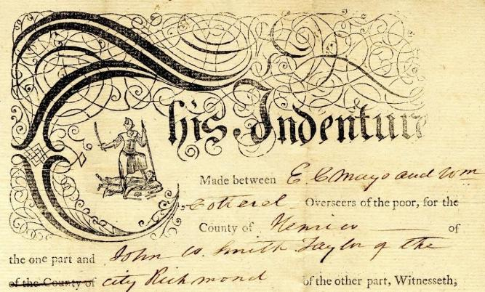
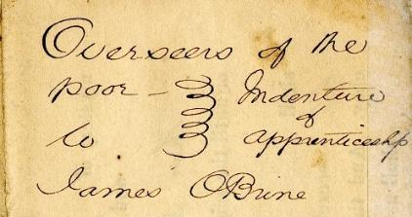
Exploring Henrico County Apprenticeship Indentures

Slide 2

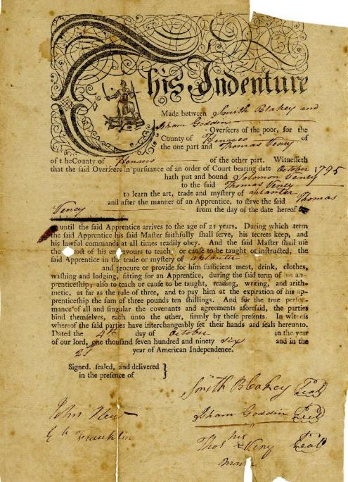
Solomon Veney
to Thomas Veney
1796 Oct 4
Henrico County (Va.) Apprenticeship Indentures, 1795-1871. Local government records collection, Henrico County Court Records. The Library of Virginia, Richmond, Virginia.

Slide 3
Solomon Veney [1]
Apprentice Name: Solomon Veney Gender & Age: male, age unknown Name of Master: Thomas Veney Job/skill: planter Apprentice agreed to: Faithfully serve Keep secrets Obey lawful commands | Master agreed to: Teach the trade Provide food, drink, clothes, washing, lodging Teach to read/write and do arithmetic to “rule of three” Was apprentice paid, and if so how much: Yes 3 pounds 10 shillings at end of term Date apprenticeship began: Oct. 4, 1796 When apprenticeship would end: Age 21
Solomon Veney to Thomas Veney, 1796 Oct. 4. Henrico County (Va.) Apprenticeship Indentures, 1795-1871. Local government records collection, Henrico County Court Records. The Library of Virginia, Richmond, Virginia.

Slide 4

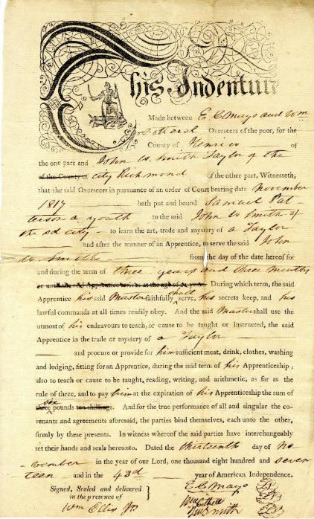
Samuel Patterson
to John W. Smith
1817 Nov 13
Henrico County (Va.) Apprenticeship Indentures, 1795-1871. Local government records collection, Henrico County Court Records. The Library of Virginia, Richmond, Virginia.

Slide 5
Samuel Patterson
[2]
Apprentice Name: Samuel Patterson Gender & Age: male, age unknown Name of Master: John W. Smith Job/skill: tailor Apprentice agreed to: Faithfully serve Keep secrets Obey lawful commands | Master agreed to: Teach the trade Provide food, drink, clothes, washing, lodging Teach to read/write and do arithmetic to “rule of three” Was apprentice paid, and if so how much: Yes 6 pounds at end of term Date apprenticeship began: Nov. 13, 1817 When apprenticeship would end: 3 years & 3 months
Samuel Patterson to John W. Smith, 1817 Nov. 13. Henrico County (Va.) Apprenticeship Indentures, 1795-1871. Local government records collection, Henrico County Court Records. The Library of Virginia, Richmond, Virginia.

Slide 6
This Indenture made this fifth day of May in the year 1820 between Daniel Edwards & Ro [Robert] Douthat, overseers of the poor for the county of Henrico of the one part and Eprhraim Speed of the said county of the other part. Witnesseth that the said Edwards & Douthat overseers of the poor as aforesaid by virtue of an order of the court of the aforesaid county bearing date the [blank] day of November 1819, have put placed and bound and by these presents do put place and bind Nathan Lewis a free boy of colour of the age of sixteen years to be an apprentice with him the said Ephraim Speed, and as an apprentice with him the said Ephraim Speed to dwell from the date of these presents until the said Nathan Lewis shall come to the age of twenty one years. according to the act of the General Assembly in that case made & provided, By and during all which time and term, the said Nathan Lewis, shall the said Ephraim Speed, his said master, well and faithfully serve in all such lawful business, as the said Nathan Lewis shall be put to by his said master, according to the power wit and ability of him the said Nathan Lewis, and honestly and obediently in all things shall behave himself towards his said master, and honestly and orderly towards the rest of the family of the said Ephraim Speed and the said Ephraim Speed for his part, for himself, his exo'rs and adm'rs, doth hereby promise and covenant to and with the said overseers of the poor, and every of them and every of their exo'rs and adm'rs and their and every of their suc[c]essors, for the time being and to and with the said Nathan Lewis, that he
the said Ephraim Speed shall the said Nathan Lewis in the craft mystery and occupation of a black smith, which he the said Ephraim Speed now uses after the best manner that he can or may teach, instruct, and inform, or cause to be taught, instructed and informed, as much as thereunto belongeth, or in any wise appertaineth. And that the said Ephraim Speed shall also find and allow unto the said apprentice sufficient meat, drink, apparel, washing lodging, and all other things needful or meat for an apprentice during the term aforesaid, and will moreover pay to the said Nathan Lewis the sum of twelve Dollars at the expiration of the aforesaid term. In Witness whereof the parties to these presents have interchangeably set their hands and seals the day and year first above written.
Nathan Lewis
to Ephraim Speed
1820 May 5
[Page 1 and 2]
Henrico County (Va.) Apprenticeship Indentures, 1795-1871. Local government records collection, Henrico County Court Records. The Library of Virginia, Richmond, Virginia.
Transcription of Indenture

Slide 7
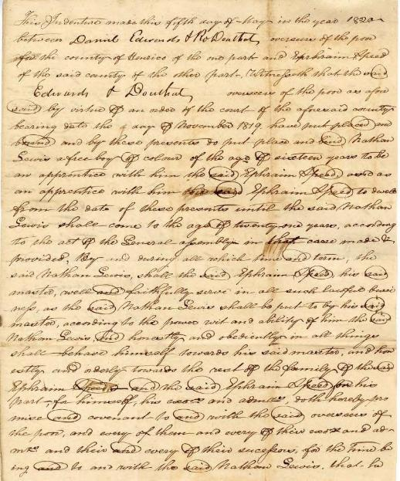
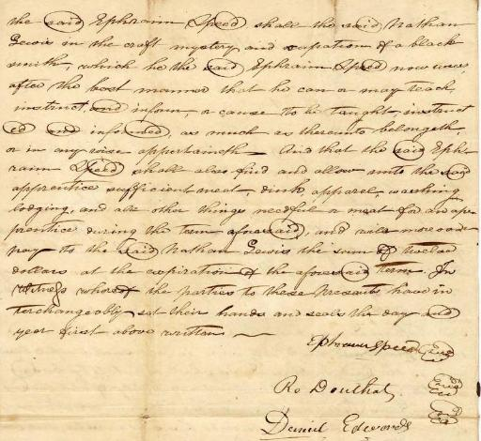
Nathan Lewis
[3]
Nathan Lewis to Ephraim Speed, 1820 May 5. Henrico County (Va.) Apprenticeship Indentures, 1795-1871. Local government records collection, Henrico County Court Records. The Library of Virginia, Richmond, Virginia.

Slide 8
Nathan Lewis
[3]
Apprentice Name: Nathan Lewis Gender & Age: male, 16, a “free boy” Name of Master: Ephraim Speed Job/skill: blacksmith Apprentice agreed to: Faithfully serve in lawful business Behave honestly/orderly toward master and rest of family | Master agreed to: Teach the trade Teach whatever else “belongeth” or “appertaineth” Provide food, drink, clothes, washing, lodging Was apprentice paid, and if so how much: Yes 12 dollars at end of term Date apprenticeship began: May 5, 1820 When apprenticeship would end: Age 21
Nathan Lewis to Ephraim Speed, 1820 May 5. Henrico County (Va.) Apprenticeship Indentures, 1795-1871. Local government records collection, Henrico County Court Records. The Library of Virginia, Richmond, Virginia.

Slide 9
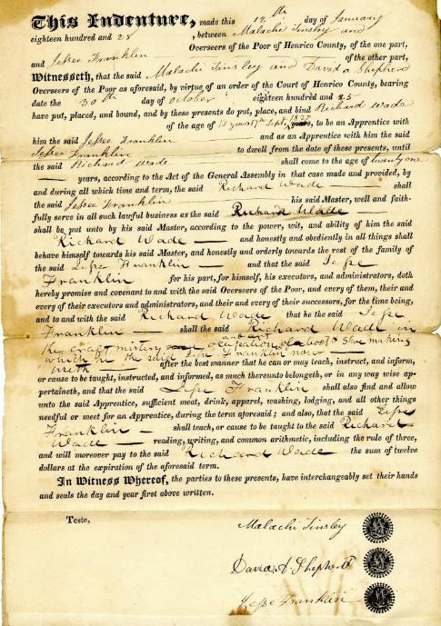
Richard Wade
to Jesse Franklin
1828 Jan 12
Henrico County (Va.) Apprenticeship Indentures, 1795-1871. Local government records collection, Henrico County Court Records. The Library of Virginia, Richmond, Virginia.

Slide 10
Richard Wade
[4]
Apprentice Name: Richard Wade Gender & Age: male, 18 Name of Master: Jesse Franklin Job/skill: shoemaker Apprentice agreed to: Faithfully serve in lawful business Behave honestly/orderly toward master and rest of family | Master agreed to: Teach the trade Teach whatever else “belongeth” or “appertaineth” Provide food, drink, clothes, washing, lodging Teach to read/write and do arithmetic to “rule of three” Was apprentice paid, and if so how much: Yes 12 dollars at end of term Date apprenticeship began: Jan 12, 1828 When apprenticeship would end: Age 21
Richard Wade to Jesse Franklin, 1828 Jan. 12. Henrico County (Va.) Apprenticeship Indentures, 1795-1871. Local government records collection, Henrico County Court Records. The Library of Virginia, Richmond, Virginia.

Slide 11
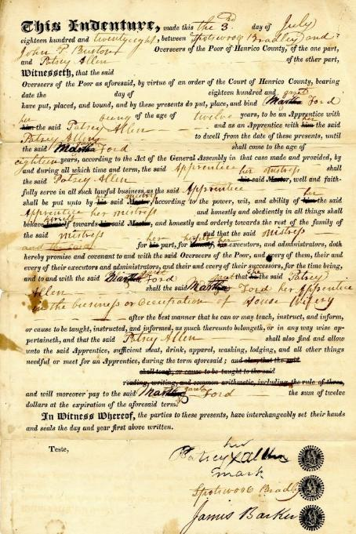
Margaret Ford
to Patsey Allen
1828 Jul 3
Henrico County (Va.) Apprenticeship Indentures, 1795-1871. Local government records collection, Henrico County Court Records. The Library of Virginia, Richmond, Virginia.

Slide 12
Margaret Ford [5]
Apprentice Name: Margaret Ford Gender & Age: female, 12 Name of Mistress: Patsey Allen Job/skill: housewifery Apprentice agreed to: Faithfully serve in lawful business Behave honestly/orderly toward master and rest of family | Master agreed to: Teach the trade Teach whatever else “belongeth” or “appertaineth” Provide food, drink, clothes, washing, lodging Was apprentice paid, and if so how much: Yes 12 dollars at end of term Date apprenticeship began: Jul 3, 1828 When apprenticeship would end: Age 18
Margaret Ford to Patsey Allen, 1828 Jul. 3. Henrico County (Va.) Apprenticeship Indentures, 1795-1871. Local government records collection, Henrico County Court Records. The Library of Virginia, Richmond, Virginia.

Slide 13
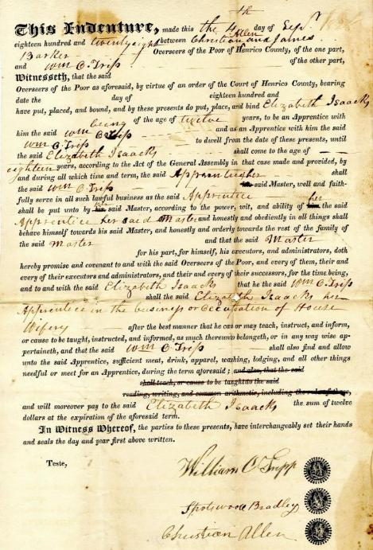
Elizabeth Isaacks
to William O. Tripp
1828 Sep 4
Henrico County (Va.) Apprenticeship Indentures, 1795-1871. Local government records collection, Henrico County Court Records. The Library of Virginia, Richmond, Virginia.

Slide 14
Elizabeth Isaacks
[6]
Apprentice Name: Elizabeth Isaacks Gender & Age: female, 12 Name of Mistress: William O. Tripp Job/skill: housewifery Apprentice agreed to: Faithfully serve in lawful business Behave honestly/orderly toward master and rest of family | Master agreed to: Teach the trade Teach whatever else “belongeth” or “appertaineth” Provide food, drink, clothes, washing, lodging Was apprentice paid, and if so how much: Yes 12 dollars at end of term Date apprenticeship began: Sep 4, 1828 When apprenticeship would end: Age 18
Elizabeth Isaacks to William O. Tripp, 1828 Sep. 4. Henrico County (Va.) Apprenticeship Indentures, 1795-1871. Local government records collection, Henrico County Court Records. The Library of Virginia, Richmond, Virginia.

Slide 15
THIS INDENTURE, made between Thos. S [Dirken? Dickenson?] and John L Bowles Overseers of the Poor for the County of Henrico of the one part, and James OBrine of the County of Henrico of the other part: Witnesseth, that the said Overseers, in pursuance of an order of court, bearing date the 4th January 1830 hath put and bound Beverly, a free boy of Colour to the said James OBrine to learn the art, trade and mystery of farming and after the manner of an Apprentice to serve the said James OBrine from the date of this Indenture or until the said Apprentice arrives at the age of twenty one years during the whole of which term, the said Apprentice shall the said James OBrine faithfully serve his secrets keep, and all his lawful commands at all times readily obey. And the said James OBrine shall use the utmost of his endeavours to teach, or cause to be taught or instructed, the said Apprentice in the trade of mystery of farming. And procure or provide for Beverly sufficient meat, drink, clothes, washing and lodging fitting for an Apprentice, during the said term of his Apprenticeship; And to pay Beverly at the expiration of his Apprenticeship, the sum of three pounds ten shillings. and for the due performance of all and singular the covenants and agreements aforesaid, the parties bind themselves each unto the other firmly by these presents.
IN WITNESS whereof, the said parties have interchangeably set their hands and seals hereunto. Dated the 14th day of June in the year of our Lord eighteen hundred and thirty two and in the 56th year of American Independence.
Thos T [Dirken? Dicken?] (SEAL) Jno L Bowles (SEAL)
James OBrine (SEAL) (SEAL)
Signed, sealed and delivered in the presence of }
In Henrico County Court Jany 4th 1830 Ordered that the Overseers of the Poor of this County bind out Beverley a free boy of Colour to James OBrine until he shall arrive at the age of twenty one years according to law, the Court adjudging the said Beverley to be five years of age in April next.
A copy Teste
Chas Wills D. C.
Beverley
to James O’Brine
1832 Jun 14
1830 Jan 4 (order)
Henrico County (Va.) Apprenticeship Indentures, 1795-1871. Local government records collection, Henrico County Court Records. The Library of Virginia, Richmond, Virginia.
Transcription of Indenture

Slide 16
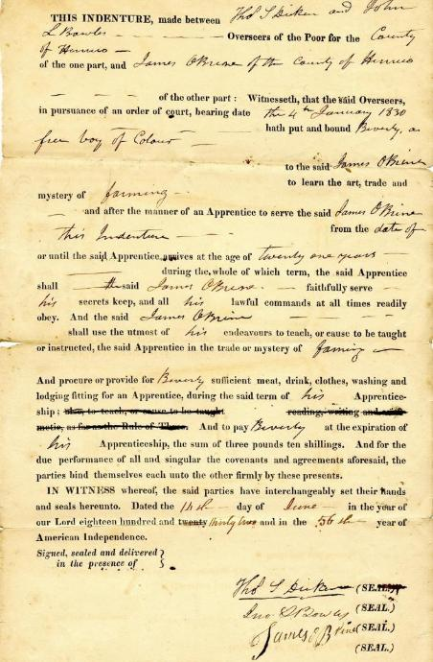
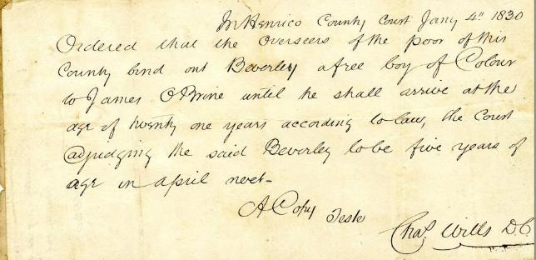
Beverley
[7]
Beverley to James O’Brine, 1832 Jun. 14. Henrico County (Va.) Apprenticeship Indentures, 1795-1871. Local government records collection, Henrico County Court Records. The Library of Virginia, Richmond, Virginia.

Slide 17
Beverley
[7]
Apprentice Name: Beverley Gender & Age: male, 5, a “free boy” [age found on second document] Name of Master: James O’Brine Job/skill: farming Apprentice agreed to: Faithfully serve Keep secrets Obey lawful commands | Master agreed to: Teach the trade Provide food, drink, clothes, washing, lodging Was apprentice paid, and if so how much: Yes 3 pounds, 10 shillings at end of term Date apprenticeship began: Jun 14, 1832 When apprenticeship would end: Age 21
Beverley to James O’Brine, 1832 Jun. 14. Henrico County (Va.) Apprenticeship Indentures, 1795-1871. Local government records collection, Henrico County Court Records. The Library of Virginia, Richmond, Virginia.

Slide 18
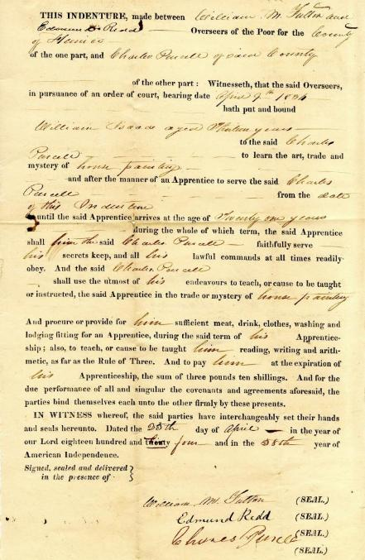
William Isaac
to Charles Purcell
1834 Apr 25
Henrico County (Va.) Apprenticeship Indentures, 1795-1871. Local government records collection, Henrico County Court Records. The Library of Virginia, Richmond, Virginia.

Slide 19
William Isaac
[8]
Apprentice Name: William Isaac Gender & Age: male, 13 Name of Master: Charles Purcell Job/skill: house painting Apprentice agreed to: Faithfully serve Keep secrets Obey lawful commands | Master agreed to: Teach the trade Provide food, drink, clothes, washing, lodging Teach to read/write and do arithmetic to “rule of three” Was apprentice paid, and if so how much: Yes 3 pounds, 10 shillings at end of term Date apprenticeship began: Apr 25, 1834 When apprenticeship would end: Age 21
William Isaac to Charles Purcell, 1834 Apr. 25. Henrico County (Va.) Apprenticeship Indentures, 1795-1871. Local government records collection, Henrico County Court Records. The Library of Virginia, Richmond, Virginia.

Slide 20
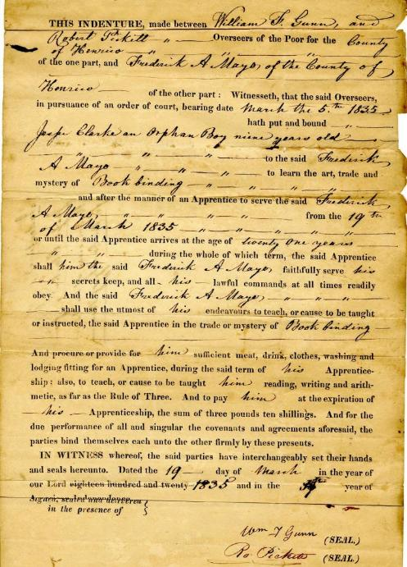
Jesse Clarke
to Frederick A. Mayo
1835 Mar 19
Henrico County (Va.) Apprenticeship Indentures, 1795-1871. Local government records collection, Henrico County Court Records. The Library of Virginia, Richmond, Virginia.

Slide 21
Jesse Clarke [9]
Apprentice Name: Jesse Clarke Gender & Age: male, 9 Name of Master: Frederick A. Mayo Job/skill: book binding Apprentice agreed to: Faithfully serve Keep secrets Obey lawful commands | Master agreed to: Teach the trade Provide food, drink, clothes, washing, lodging Teach to read/write and do arithmetic to “rule of three” Was apprentice paid, and if so how much: Yes 3 pounds, 10 shillings at end of term Date apprenticeship began: Mar 19, 1835 When apprenticeship would end: Age 21
Jesse Clarke to Frederick A. Mayo, 1835 Mar. 19. Henrico County (Va.) Apprenticeship Indentures, 1795-1871. Local government records collection, Henrico County Court Records. The Library of Virginia, Richmond, Virginia.

Slide 22
This Indenture, made this 12th day of December eighteen hundred and Forty two, between Nicholas Ware and J B Keesee Overseers of the poor of Henrico County, of the one part, and Nathaniel Q. Crow of the other part, Witnesseth, that the said Nicholas Ware & JB Keesee Overseers of the Poor as aforesaid, by virtue of an order of the Court of Henrico County, bearing date the 5th day of December eighteen hundred and Forty two have put, placed, and bound, and by these presents do put, place, and bind Thomas Spurlock a free boy of colour of the age of eighteen years, to be an Apprentice with him the said Nathaniel Q. Crow and as an Apprentice with him the said Nathaniel Q. Crow to dwell from the date of these presents, until the said Thomas Spurlock shall come to the age of twenty one years, according to the Act of the General Assembly in that case made and provided, by and during all which time and term, the said Thomas Spurlock shall the said Nathaniel Q. Crow his said Master, well and faithfully serve in all such lawful business as the said Thomas Spurlock shall be put unto by his said Master, according to the power, wit, and ability of him the said Thomas Spurlock and honestly and obediently in all things shall behave himself towards his said Master, and honestly and orderly towards the rest of the family of the said Nathaniel Q. Crow and that the said Nathaniel Q. Crow for his part, for himself, his executors, and administrators, doth hereby promise and covenant to and with the said Overseers of the Poor, and every of them, their and every of their executors and administrators, and their and every of their successors, for the time being, and to and with the said Thomas Spurlock that he the said Nathaniel Q. Crow shall the said Thomas Spurlock, Learn the trade of a Carpenter after the best manner that he can or may teach, instruct, and inform, or cause to be taught, instructed, and informed, as much thereunto belongeth, or in any way wise appertaineth, and that the said Nathaniel Q. Crow shall also find and allow unto the said Apprentice, sufficient meat, drink, apparel, washing, lodging, and all other things needful or meet for an Apprentice during the term aforesaid; and also, to pay the sum of twenty five dollars per annum for the services of said boy according to Law in such cases made & provided.
In Witness Whereof, the parties to these presents, have interchangeably set their hands and seals the day and
year first above written. Nicholas [Ware? Ward?] (SEAL) JB Keesee (SEAL)
Nath'l Q. Crow (SEAL) Teste,
Thomas Spurlock
to Nathaniel Crow
1842 Dec 12
Henrico County (Va.) Apprenticeship Indentures, 1795-1871. Local government records collection, Henrico County Court Records. The Library of Virginia, Richmond, Virginia.

Slide 23
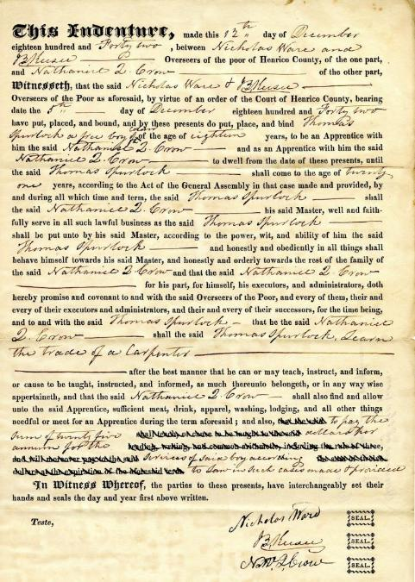
Thomas Spurlock
[10]
Thomas Spurlock to Nathaniel Crow, 1842 Dec. 12. Henrico County (Va.) Apprenticeship Indentures, 1795-1871. Local government records collection, Henrico County Court Records. The Library of Virginia, Richmond, Virginia.

Slide 24
Thomas Spurlock
[10]
Apprentice Name: Thomas Spurlock Gender & Age: male, 18, a “free boy” Name of Master: Nathanial Crow Job/skill: carpenter Apprentice agreed to: Faithfully serve in lawful business Behave honestly/orderly toward master and rest of family | Master agreed to: Teach the trade Provide food, drink, clothes, washing, lodging Was apprentice paid, and if so how much: Yes 25 dollars per year Date apprenticeship began: Dec 12, 1842 When apprenticeship would end: Age 21
Thomas Spurlock to Nathaniel Crow, 1842 Dec. 12. Henrico County (Va.) Apprenticeship Indentures, 1795-1871. Local government records collection, Henrico County Court Records. The Library of Virginia, Richmond, Virginia.

Slide 25

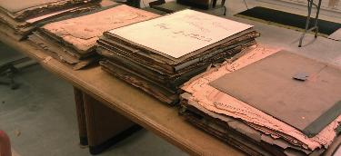
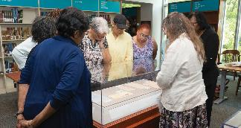
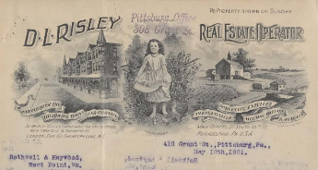
Explore More
The documents for this activity were selected from Henrico County (Va.) Apprenticeship Indentures, 1795-1871. This collection contains documentation for over 80 individuals, so there are many more to see.
As of 2025, the Library of Virginia has finding aids for collections of original apprenticeship indentures processed and made available for 40 localities. Come visit LVA and explore them!
Many apprenticeship indentures involving Black or multiracial people from many localities have been scanned and are available digitally, often with transcriptions, at Virginia Untold: The African American Narrative.
See specifically LVA’s Uncommonwealth blog 5/27/2020 The Farmer’s Apprentice: African American Indentures of Apprenticeship in Virginia

