Slide 1
Civil War:
Writs of Habeas Corpus

Slide 2

Writ 1: James Bellew
The petition of William Bellew respectfully represents that his son James Bellew is now detained in the custody of Captain ___ Pace, commanding Company I, Col. McEnery’s Regiment under a claim that he is liable to military service for local defense. That the said James Bellew was fifteen years of age on the 12th day of December 1864, and is therefore not so liable. Therefore your petitioner asks that your Honor will award to him the writ of habeas corpus to the said Captain Pace directed, requiring him to have before you the body of the said James Bellew with the causes of his detention, so that the same may be enquired into and relief afforded your petitioner.
Bellew, James, 1865. Richmond (Va.) Writs of Habeas Corpus, 1861-1866. Local government records collection, Richmond (City) Court Records. The Library of Virginia, Richmond, Virginia, 23219.

Slide 3

Writ 2: John H. Clarkson
The petition of John H. Clarkson of the county of Essex respectfully represents that he is a farmer in the said county, and upon his plantation there were on the first day of January 1864 and are still fifteen able bodied field hands between the ages of sixteen and fifty. There is not upon the plantation any white male attndt not liable to military service. He was the owner and manager of the said farm on the 1st day of January 1864, and owns and manages it still. No person has been exempted from military service as owner and manager or overseer of the said plantation. On or about the ___ day of October last he made application in due form to Lieut. Th. G. Bumpass enrolling officer of the county of Essex for exemption in pursuance of the provisions of the IV article of the 10th section of the Act of Congress entitled “An act to organize forces to serve during the war” approved February 17th, 1864. Along with his application which was in writing he tendered to the said Lieut. Bumpass, a bond in the form and penalty prescribed by the Secretary of War with two good and sufficient securities payable to the Confederate States of America and conditioned as required by the said IV article of the 10th section of the said Act of Congress. The said Lieut. Bumpass declined to receive or entertain the said application, and ordered your petitioner to report to Camp Lee for duty, which he did accordingly, and is now held in custody as a conscript by Capt. William H. Fry commandant of Camp Lee.
Your petitioner is advised that he is entitled to exemption, and is illegally detained and prays a writ of Habeas Corpus at such jurindum directed to the said Captain William H. Fry commandant of Camp Lee commanding him &c and that your petitioner may be discharged &c. And in such duty bound will ever pray.
Clarkson, John H., 1865. Richmond (Va.) Writs of Habeas Corpus, 1861-1866. Local government records collection, Richmond (City) Court Records. The Library of Virginia, Richmond, Virginia, 23219.

Slide 4
Writ 3: Thomas Rourke
Your petitioner Thomas Rourke respectfully represents that he is a citizen of the Government of Great Britain and Ireland, that he was born in the latter country, as his protection papers will show that he came to the United States in the year 1849 and came south to Virginia in the year 1858, that he left his native country where his parents are now residing, intending to return to it, that it has always been and is still his intention to return home, that he has never taken any step, of any kind, to become a citizen of this country, has never voted, never owned any real estate, is a single man and by vocation a clerk, has one fixed domicile, that he would have left long afore this, but for the troubles of this country by which he was prevented getting to a safe and cheap transit. He has been doing duty in the Regiment of Col. Evans, and while so engaged was arrested, and is now held as a conscript at Camp Lee in the charge of Wm H. Fry. He respectfully asks that being regarded as a domiciled foreigner the writ of habeas corpus ad subjiciendum shall be fore with granted by your Honor, returnable to such day as he may appoint. Directing the said Capt. Wm H. Fry to bring or cause to be brought the body of your petitioner before your Honor, with a return of the cause of his detention.
Rourke, Thomas, 1865. Richmond (Va.) Writs of Habeas Corpus, 1861-1866. Local government records collection, Richmond (City) Court Records. The Library of Virginia, Richmond, Virginia, 23219.

Slide 5
Writ 4: E. G. Hudgens
The petition of E. G. Hudgens for a writ of Habeas Corpus.
Your petitioner respectfully represents that he is now unlawfully and without authority held and detained in military custody at Camp Lee by Major J. G. Peyton as a conscript. He avers that he put in a substitute, for the war, on 7th day of Novem. 1861 according to military regulations of the 20th Oct. 1861 and was regularly discharged.
He prays that a writ of Habeas Corpus may be awarded him, directed to Col H. G. Miles and Major J. G. Peyton, at Camp Lee, requiring them or whoever may claim so to hold and detain your petitioner, to bring the body of your petitioner before your honor together with the cause of his detention also to produce in court, his papers, discharge, application by your petitioner which are now at Camp Lee in the custody of the said Maj. J. G. Peyton by which it will fully appear that your petitioner has been regularly discharged and is besides this now a captain on a freight boat running on J. R. & K. Canal and Wells River. The said papers contain all the proper testimony, with the endorsement of Col. G. C. Shields as to these parts &c.
Hudgens, E.G., 1863. Richmond (Va.) Writs of Habeas Corpus, 1861-1866. Local government records collection, Richmond (City) Court Records. The Library of Virginia, Richmond, Virginia, 23219.

Slide 6
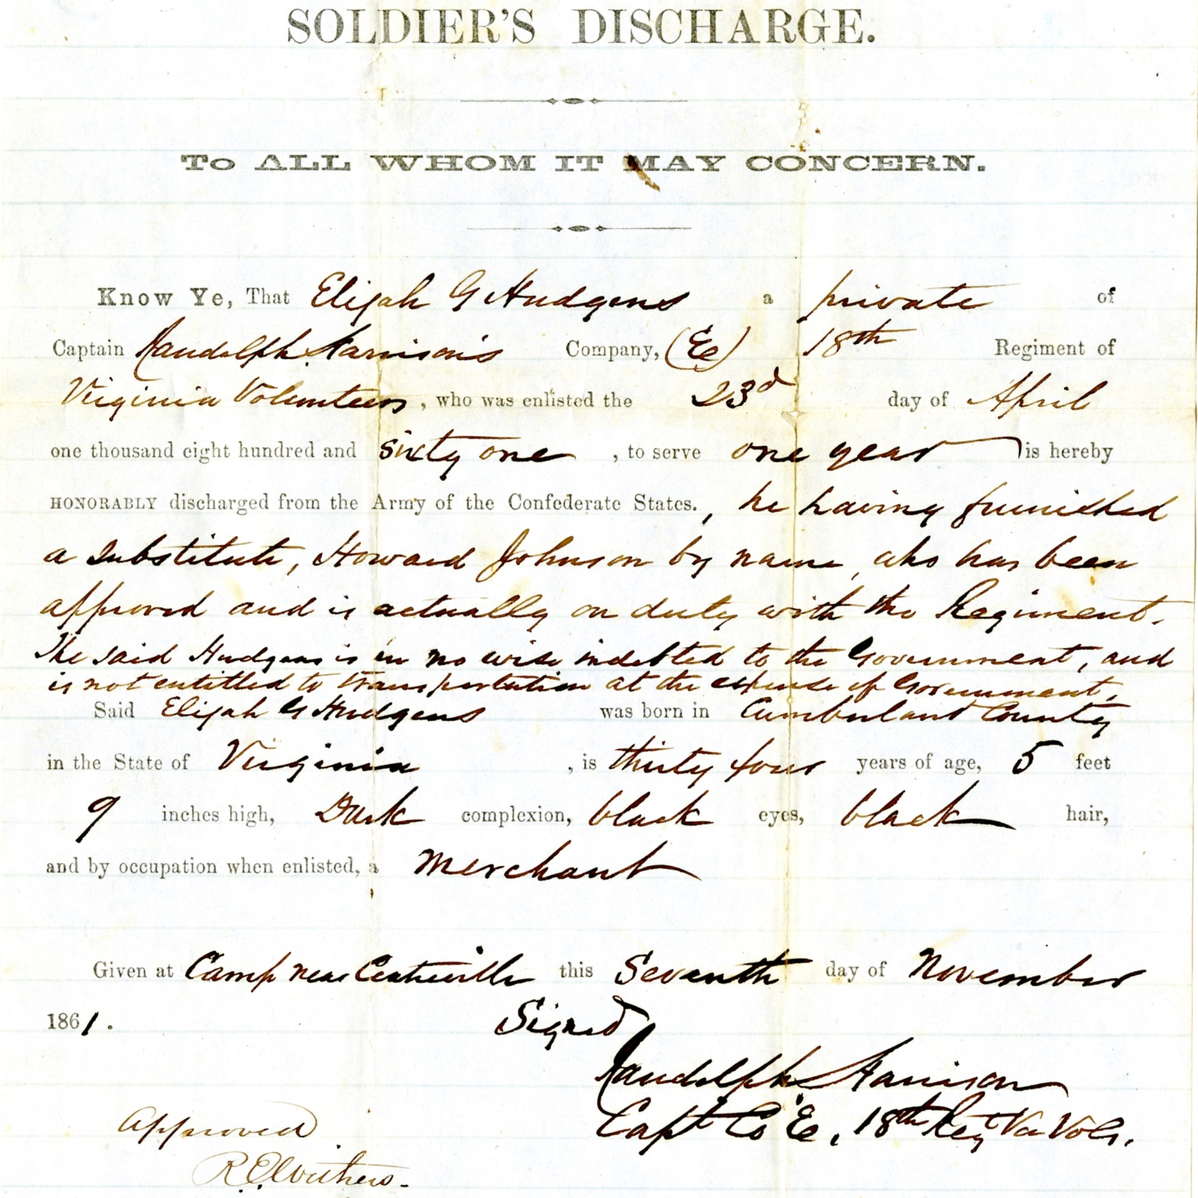
Notes:
Hudgens’ discharge from the Confederate Army for providing a substitute, included as evidence in his writ of habeas corpus.

Slide 7
Writ 5: John D. L. Petross
The petition of John D. L. Petross, respectfully represents, that he is unlawfully held and detained, in military service, by John A. Henderson Capt. Co. D 38th Va. Regt. Stewart’s Brgd.
Your petitioner was conscripted in the fall of 1864 and was then over the age of thirty years and had been, for more than seven years previous to that date, a regular practicing physician in the counties of Henry and Pittsylvania, where he was in the regular and habitual practice of his profession. When he was ordered to Camp Lee, he was assigned before he could prepare his papers and proof for the purpose of discharge as a physician.
Your petitioner exhibits with his petition sundrie statements, affidavits, and applications showing the facts of his case and the merits of his application. He prays that a writ of Habeas Corpus may be awarded and directed to the said John A. Henderson Capt. Co. D 38th Va. Regt. Stewart’s Brigade requiring him to have and bring the body of your petitioner before your Honorable Court, together with the cause of his said detention that the same may be enquired into and proper relief had.
Petross, John D. L., 1866. Richmond (Va.) Writs of Habeas Corpus, 1861-1866. Local government records collection, Richmond (City) Court Records. The Library of Virginia, Richmond, Virginia, 23219.

Slide 8
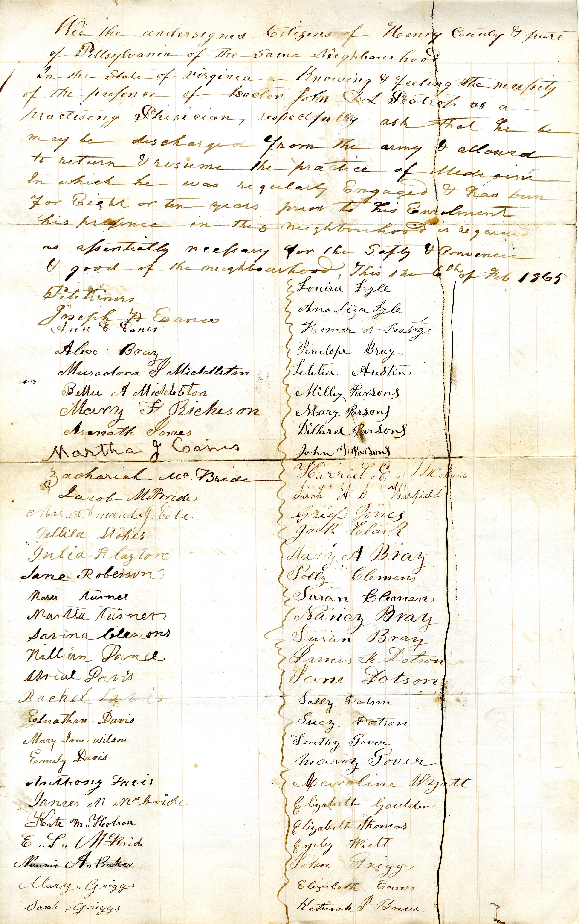
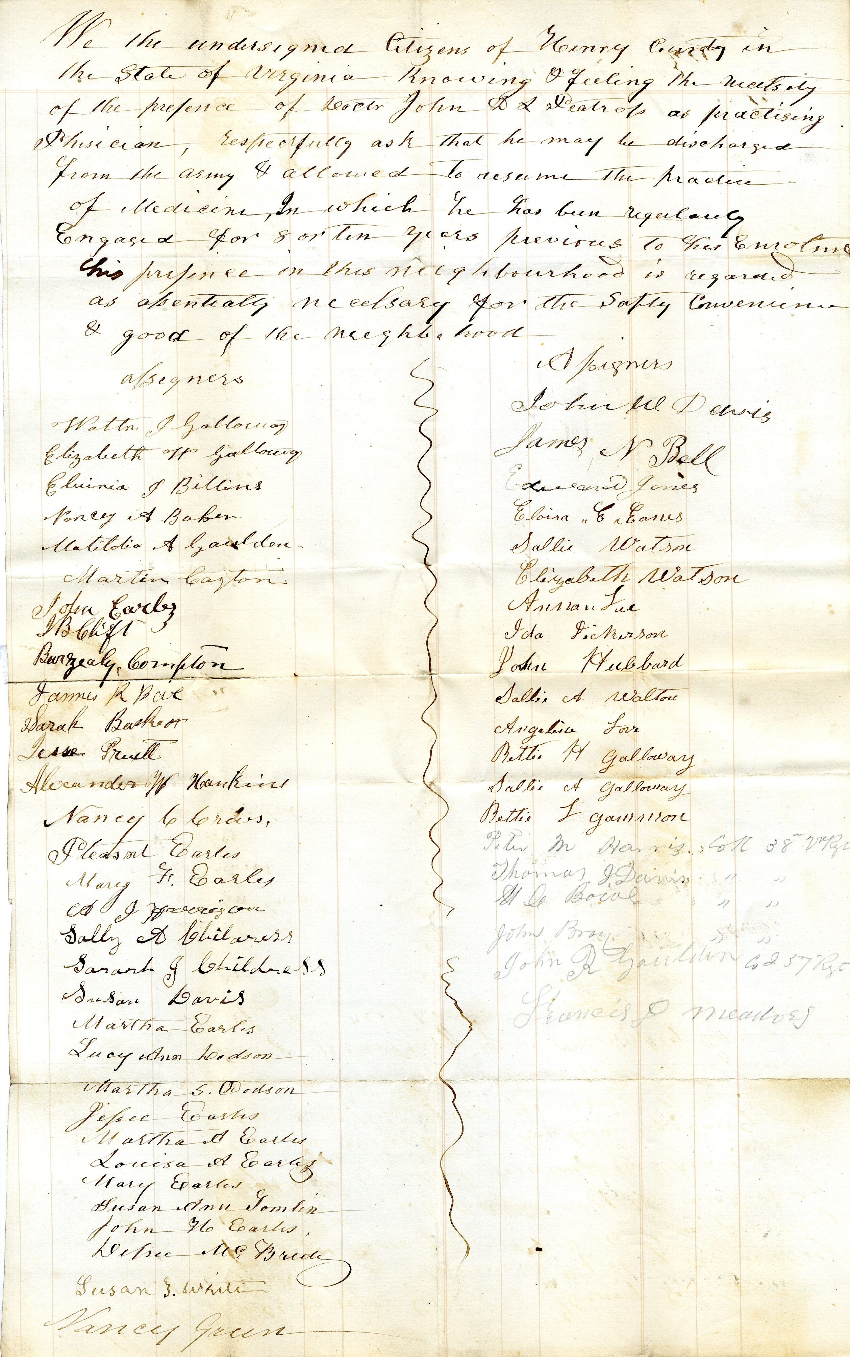
Notes:
Petitions signed by residents of Pittsylvania and Henry counties regarding the importance of having Petross as a physician in their communities. Included as evidence in his writ of habeas corpus.

Slide 9
Writ 6: Andrew G. Hudson
The petition of Andrew G. Hudson respectfully represents that he is unlawfully detained as a conscript of Col. J. G. Shields at Camp Lee or Major Tho. G. Peyton. He alleges that on the 21st day of June 1862 he placed a substitute in his place as a member of Co. A. 19th Regiment, who was accepted by the Capt. of said Co. with the consent & approval of Col. Stranger who commanded the regiment & thereupon he obtained his discharge.
He further alleges, that this discharge has been respected hitherto & he has been three times exempted upon it by the enrolling officers in his district.
He therefore protests that he is not liable to military service & prays that a writ of Habeas Corpus may be directed to said Shields & Peyton requiring them to bring your petitioner that he may be discharged.
Hudson, Andrew G., 1863. Richmond (Va.) Writs of Habeas Corpus, 1861-1866. Local government records collection, Richmond (City) Court Records. The Library of Virginia, Richmond, Virginia, 23219.

Slide 10
Writ 7: Andrew Mull
Your petitioner James Mull respectfully represents that he is a citizen of the state of Virginia and has been engaged for some time past in building bridges and other work for the Confederate Government and is still so engaged.
That about the month of March last whilst your petitioner was absent from the city of Richmond (his place of residence) his son Alexander Mull a boy only 15 years of age enlisted as a soldier in the company known as the Presidents Guard commanded by Captain Wm S. Reid. Your petitioner did not know of the enlistment when made and never gave his consent to the same. Application has been made for the discharge of his son at a time when he suffered from the effects of fever but without success.
Your petitioner charges that his son is detained illegally by said Captain Wm S. Reid contrary to law and without authority. Therefore he prays your Honor to award him the writ of Habeas Corpus to the said Capt Reid directly requiring him to bring before you the body of said Alexander Mull with the causes of his detention so that the same may be enquired into and relief afforded to your petitioner.
Mull, Andrew, 1863. Richmond (Va.) Writs of Habeas Corpus, 1861-1866. Local government records collection, Richmond (City) Court Records. The Library of Virginia, Richmond, Virginia, 23219.

Slide 11
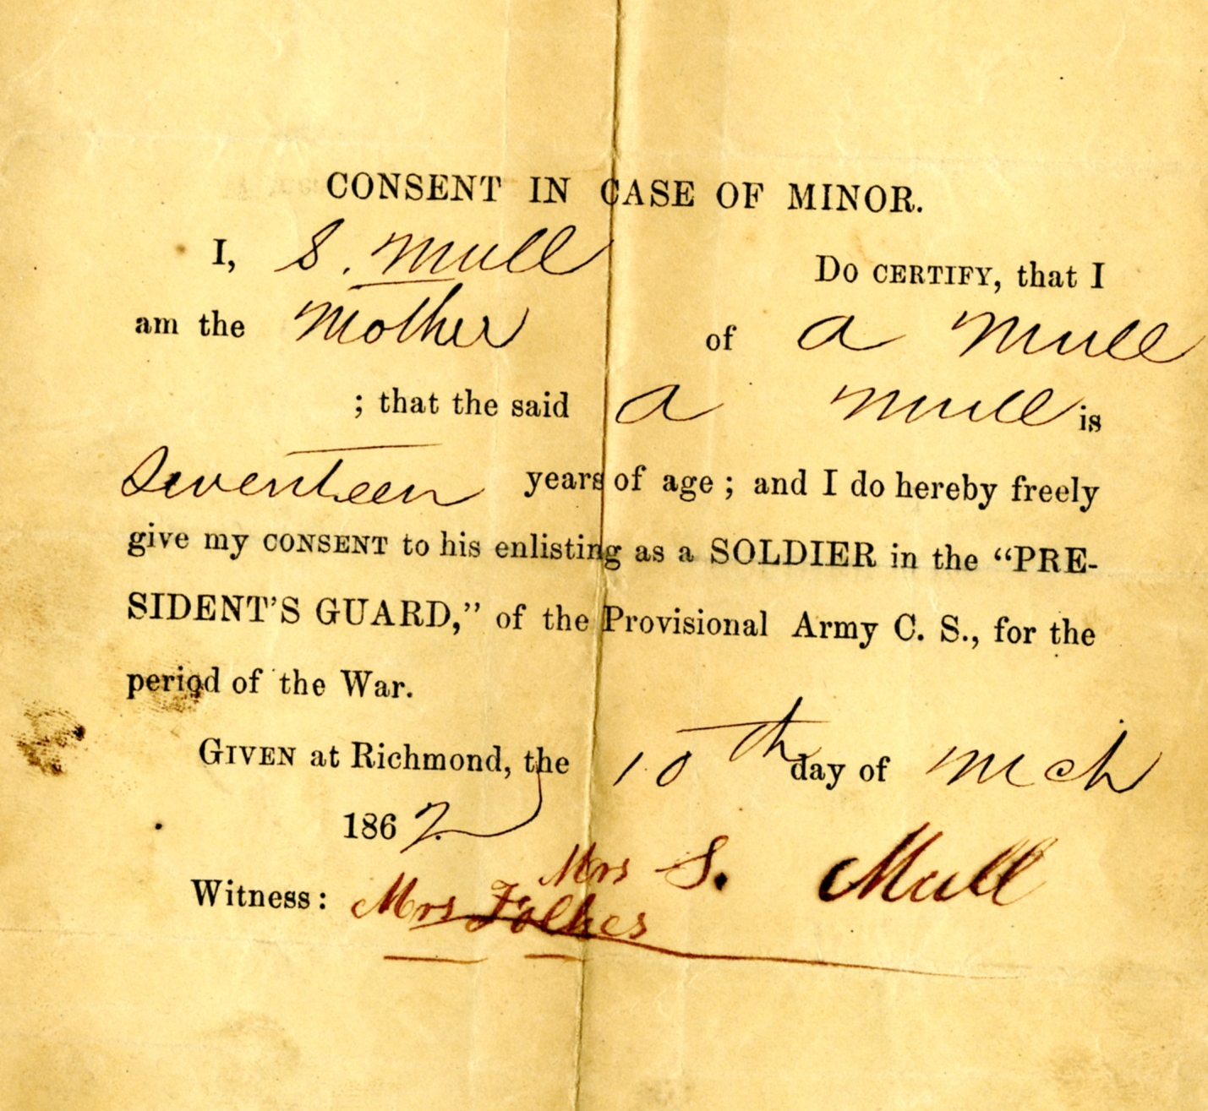
Notes:
Consent in case of a minor, filed by Mull’s mother on his behalf. His age is listed as seventeen, not fifteen as his father claimed in his petition. Filed as evidence with his writ of habeas corpus.

Slide 12
Writ 8: C. T. DeCӓniél
Your petitioner C. T. DeCӓniél respectfully represents that he is illegally detained in custody by Captain George L. Bidgood, a captain of a militia company in the 19th Regiment of the Virginia Militia, first class militia. Your petitioner states that the said Bidgood detains him as he is informed claiming that he owes military service in the said militia. Your petitioner is not a citizen of Virginia, has never declared his intention to become a citizen of the former United States or the Confederate States of America or of any of the states of the former union or of the present confederacy. Your petitioner was born in Devonshire England and is a subject of Queen Victoria, Queen of the United Kingdom of Great Britain and Ireland. Your petitioner is yet a subject of said monarch, never having relinquished his domicile in the kingdom of his birth and never designed to do so. As an unnaturalized foreigner, your petitioner is not liable to perform the military service sought to be exacted of him.
Your petitioner further states that his health is such as wholly to incapacitate him for the discharge of the militia duties required and on the ground of physical disability he is entitled to relief from the duties. Should it become necessary in the case your petitioner believes he can make this abundantly appear to your honor.
Your petitioner prays that the said Captain George L. Bidgood be advised to have the body of your petitioner before your honor together with the day and cause of your petitioner’s capture and detention, and that your petitioner be discharged and released from the custody and control of said captain. And your petitioner will ever pray & c.
DeCӓniél, C. T, 1866. Richmond (Va.) Writs of Habeas Corpus, 1861-1866. Local government records collection, Richmond (City) Court Records. The Library of Virginia, Richmond, Virginia, 23219.

Slide 13

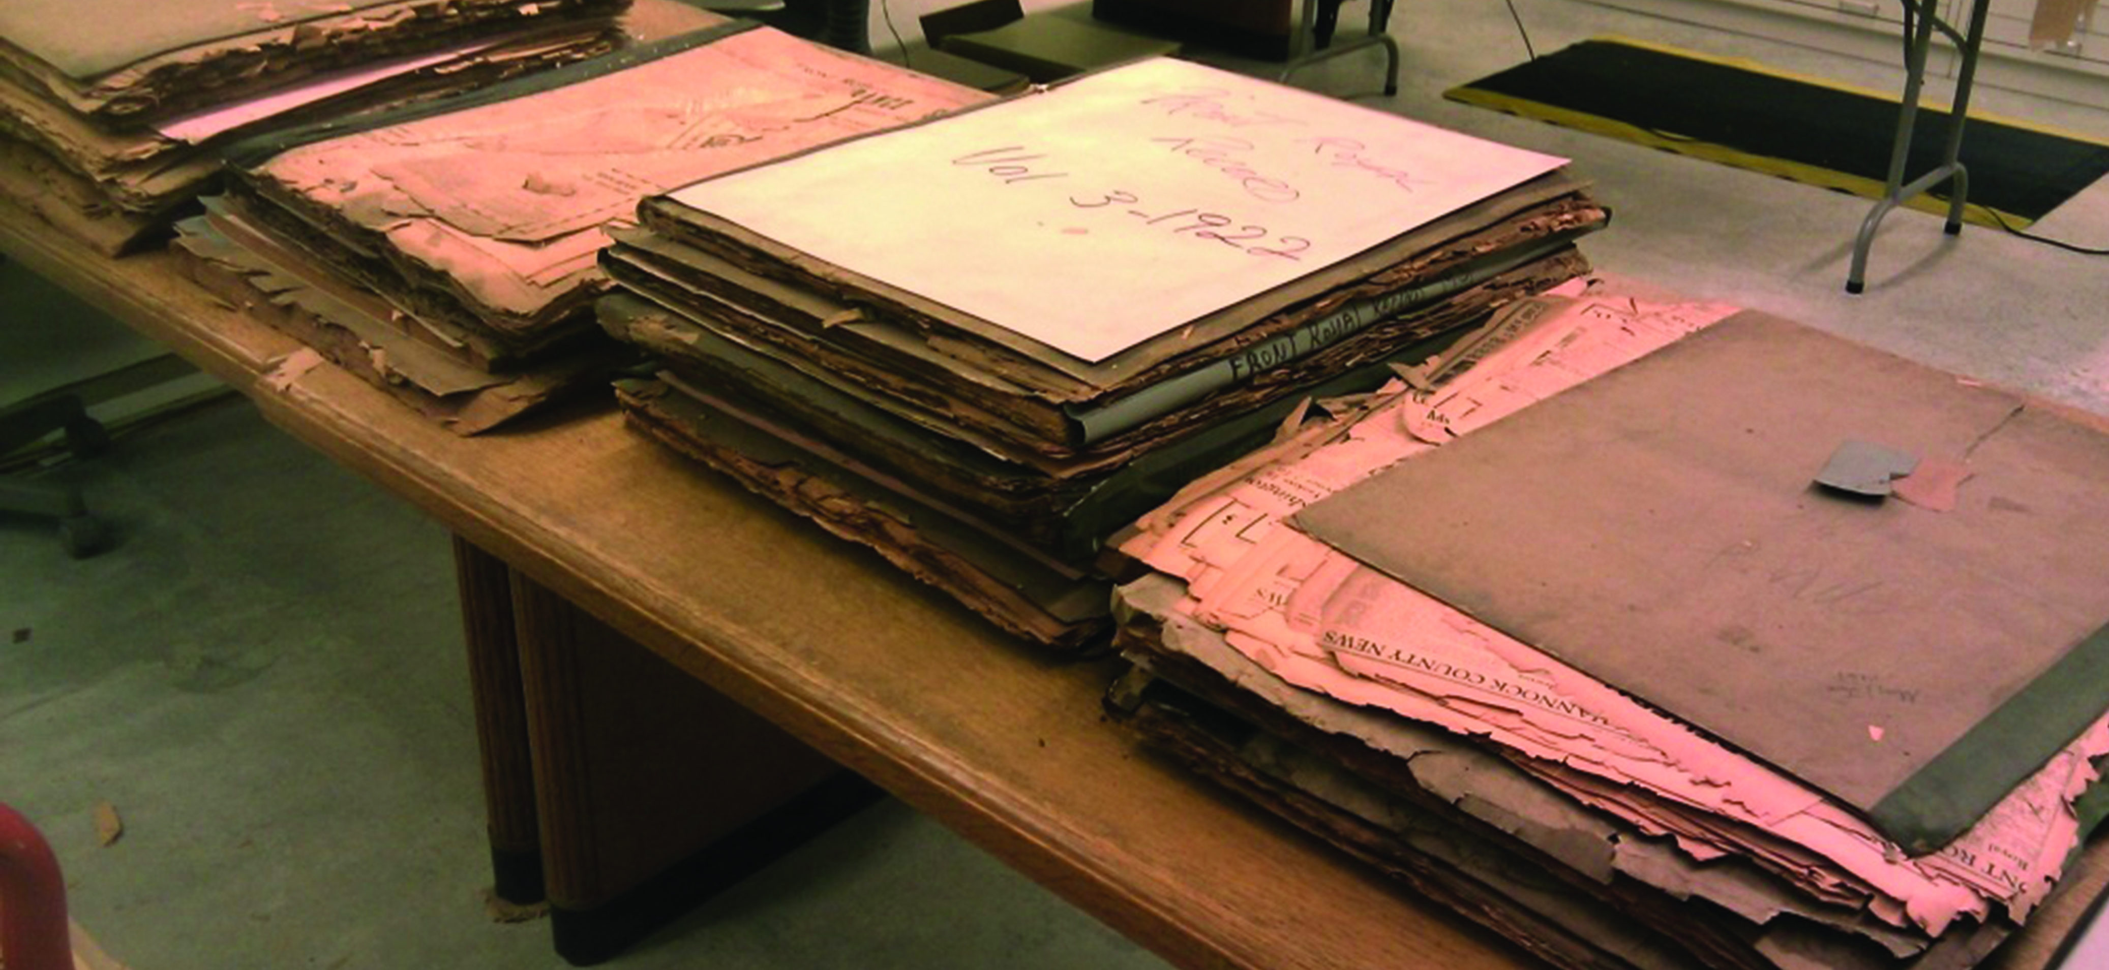
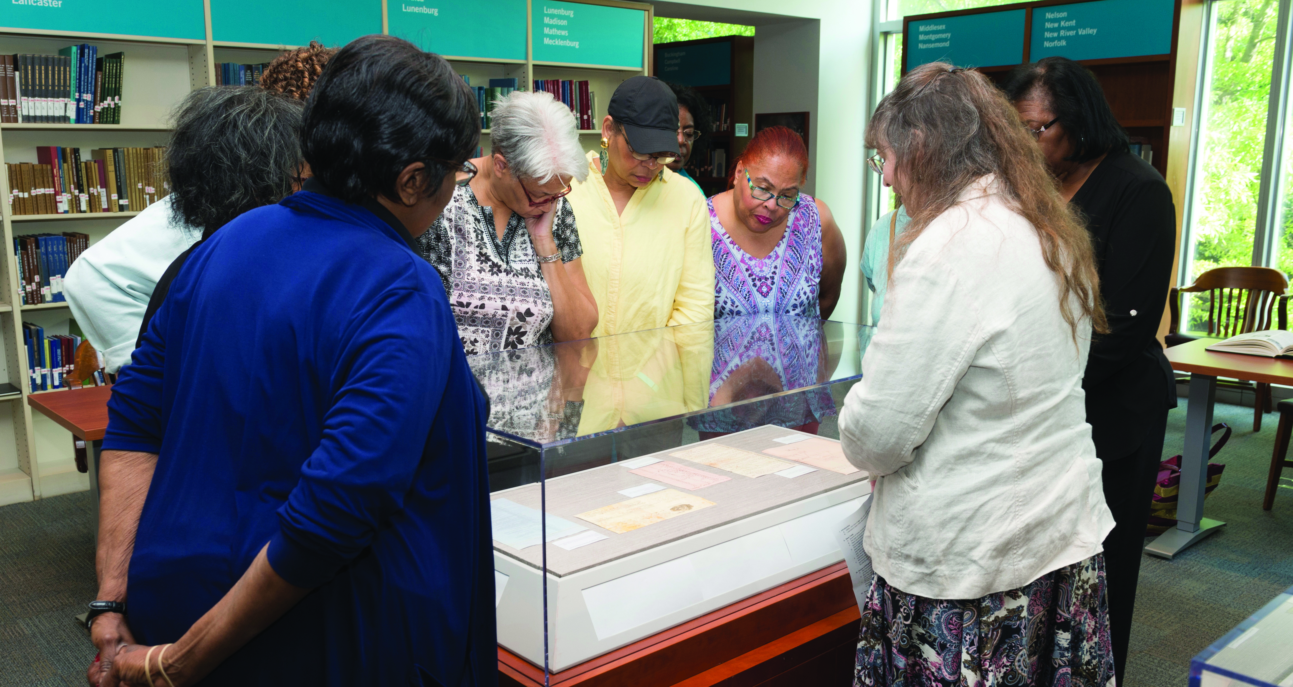
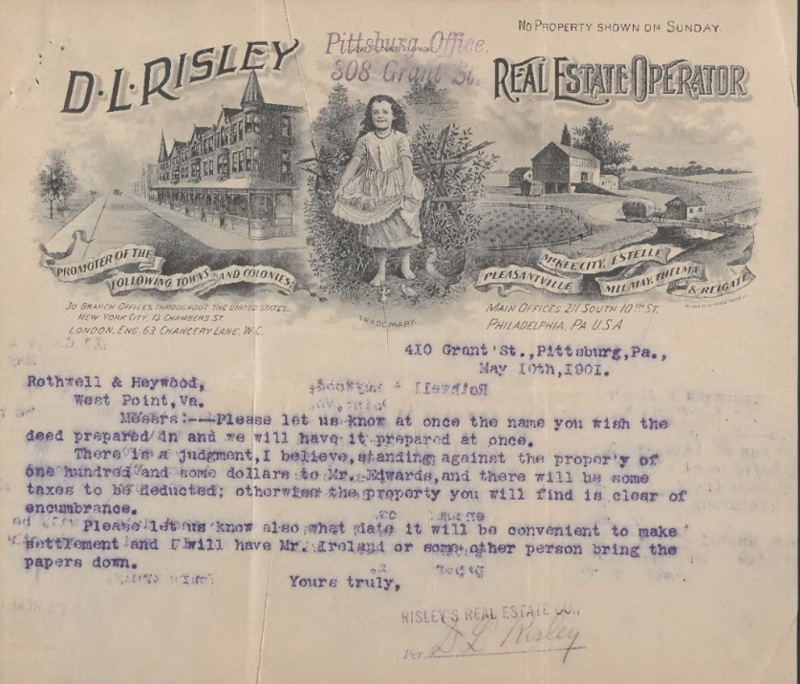
Explore More
Virginia in the Civil War research guide – provides an overview of major subjects pertaining to the history of Virginia during the Civil War, as well as links to many additional sources for further research.
Using Virginia Civil War Service and Veterans Records research guide – provides an overview of sources for many other types of Civil War military service records from both the Union and the Confederacy.

