Slide 1
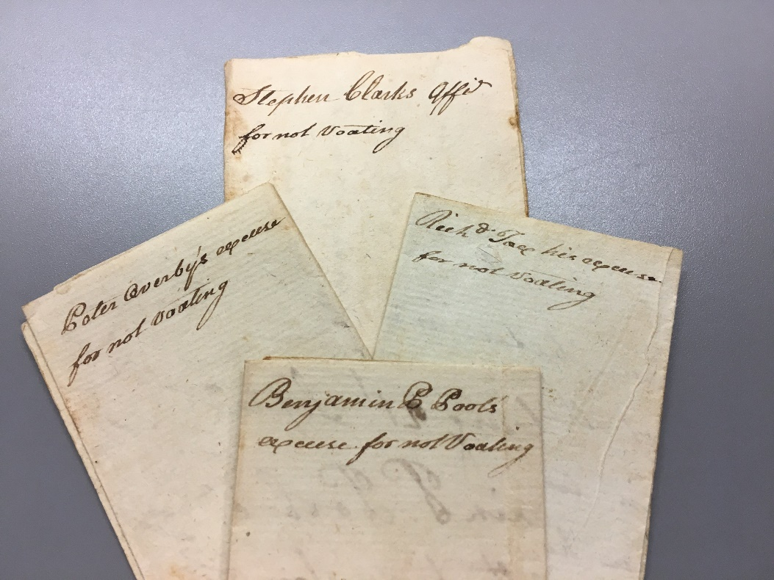
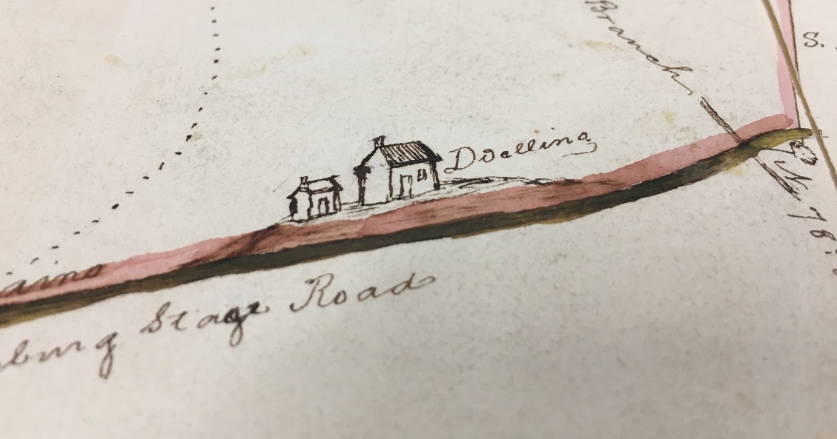
Exploring Mecklenburg County Election Excuses (1793)
Drawing of a “Dwelling” from plat in Richmond City Deed Book 1861-1865

Slide 2

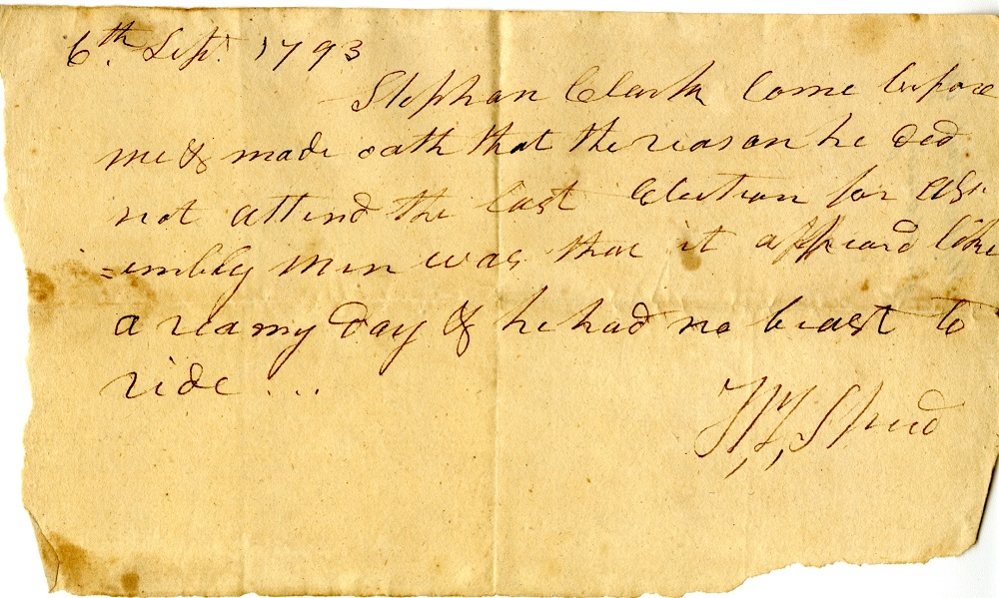
Clarke, Stephan. Mecklenburg County (Va.) Election Records: Election Excuses, 1793. Local government records collection, Mecklenburg County Court Records. The Library of Virginia, Richmond, Virginia, 23219.

Slide 3
Stephan Clarke [1]
6th Sept. 1793
Stephan Clark Came before me & made oath that the reason he did not attend the last election for afsembly man was that it appeard like a reany day & he had no beast to ride… [N,Y, Sperd]
Clarke, Stephan. Mecklenburg County (Va.) Election Records: Election Excuses, 1793. Local government records collection, Mecklenburg County Court Records. The Library of Virginia, Richmond, Virginia, 23219.

Slide 4

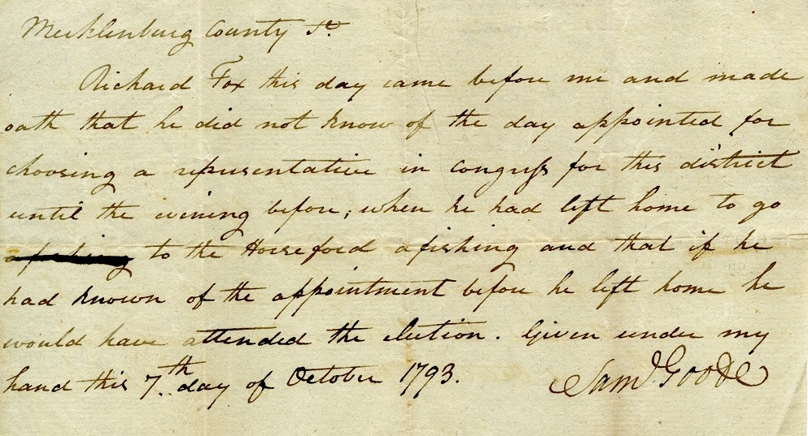
Fox, Richard. Mecklenburg County (Va.) Election Records: Election Excuses, 1793. Local government records collection, Mecklenburg County Court Records. The Library of Virginia, Richmond, Virginia, 23219.

Slide 5
Richard Fox
[2]
Mecklenburg County
Richard Fox this day came before me and made oath that he did not know of the day appointed for choosing a representative in Congrefs for this district until the evening before, when he had left home to go a fishing to the Horseford a fishing and that if he had known of the appointment before he left home he would have attended the election. Given under my hand this 7th day of October 1793.
Saml Goode
Fox, Richard. Mecklenburg County (Va.) Election Records: Election Excuses, 1793. Local government records collection, Mecklenburg County Court Records. The Library of Virginia, Richmond, Virginia, 23219.

Slide 6
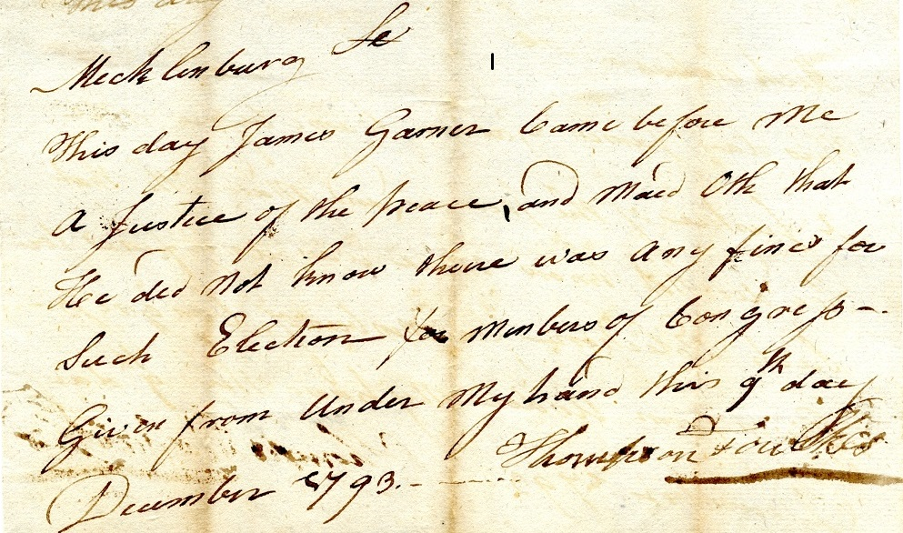
Garner, James. Mecklenburg County (Va.) Election Records: Election Excuses, 1793. Local government records collection, Mecklenburg County Court Records. The Library of Virginia, Richmond, Virginia, 23219.

Slide 7
James Garner
[3]
Mecklenburg
This day James Garner Came before Me a Justice of the peace and maed Oth (sic) that He did not know there was any fine for Such election for members of Congrefs~. Given from Under My hand this 9th day December 1793. Thompson Foulkes
Garner, James. Mecklenburg County (Va.) Election Records: Election Excuses, 1793. Local government records collection, Mecklenburg County Court Records. The Library of Virginia, Richmond, Virginia, 23219.

Slide 8
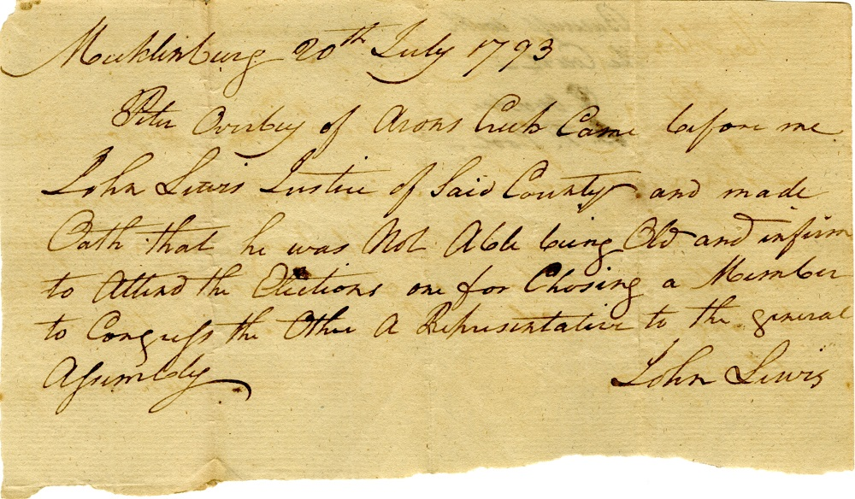
Overby, Peter. Mecklenburg County (Va.) Election Records: Election Excuses, 1793. Local government records collection, Mecklenburg County Court Records. The Library of Virginia, Richmond, Virginia, 23219.

Slide 9
Peter Overby
[4]
Mecklenburg 20th July 1793
Peter Overby of Arons Cub Came before me John Lewis Justice of Said County and made Oath that he was Not Able being Old and infirm to Attend the Election one for Chosing (sic) a Member to congrefs the Other a Representative to the general Afsembly. John Lewis
Overby, Peter. Mecklenburg County (Va.) Election Records: Election Excuses, 1793. Local government records collection, Mecklenburg County Court Records. The Library of Virginia, Richmond, Virginia, 23219.

Slide 10
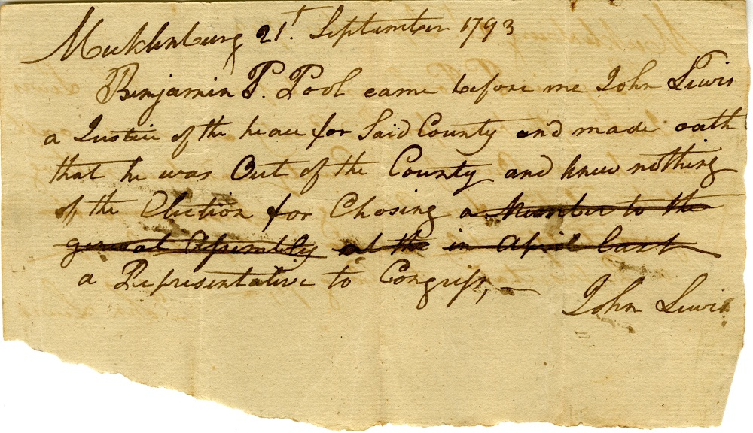
Poole, Benjamin P. Mecklenburg County (Va.) Election Records: Election Excuses, 1793. Local government records collection, Mecklenburg County Court Records. The Library of Virginia, Richmond, Virginia, 23219.

Slide 11
Benjamin P. Poole
[5]
Mecklenburg 21st September 1793
Benjamin P. Pool came before me John Lewis a Justice of the peace for Said County made oath that he was Out of the County and knew nothing of the Election for Chosing (sic) a member to the general Afsembly at the in April last a Representative to Congrefs, John Lewis
Poole, Benjamin P. Mecklenburg County (Va.) Election Records: Election Excuses, 1793. Local government records collection, Mecklenburg County Court Records. The Library of Virginia, Richmond, Virginia, 23219.

Slide 12
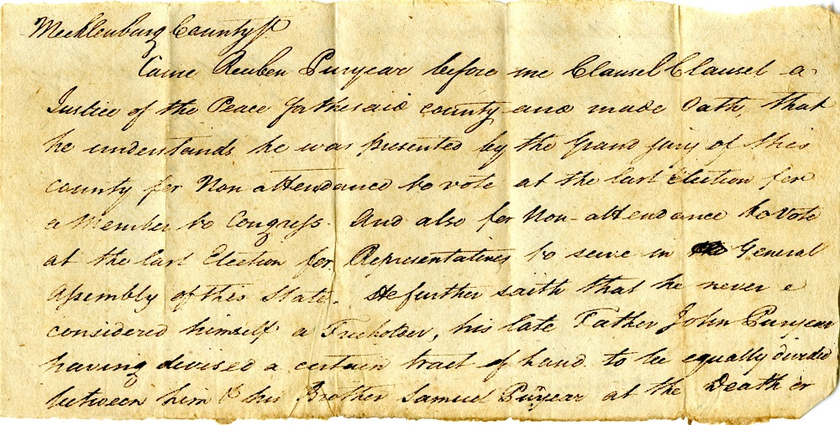
Puryear, Reuben. Mecklenburg County (Va.) Election Records: Election Excuses, 1793. Local government records collection, Mecklenburg County Court Records. The Library of Virginia, Richmond, Virginia, 23219.

Slide 13
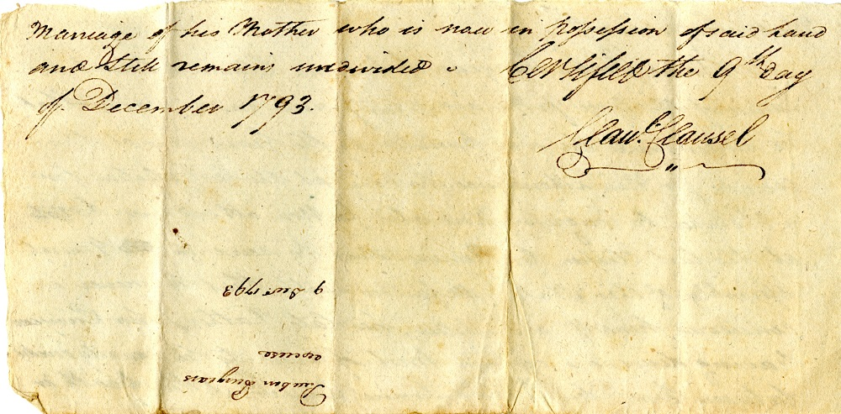
Puryear, Reuben. Mecklenburg County (Va.) Election Records: Election Excuses, 1793. Local government records collection, Mecklenburg County Court Records. The Library of Virginia, Richmond, Virginia, 23219.

Slide 14
Reuben Puryear
[6]
Mecklenburg County
Came Reuben Puryear before me Clausel Clausel a Justice of the Peace for the said county and made Oath that he understands he was presented by the Grand jury of this county for Non-attendance to vote at the last Election for a Member to Congrefs. And also for Non-attendance to vote at the last Election for Representatives to serve in the General Afsembly of this State. He further saith that he never considered himself a Freeholder, his late Father John Puryear having devised a certain tract of land to be equally divided between him & his Brother Samuel Puryear at the Death or Marriage of his Mother who is now in pofsefsion of said land and still remains undivided. Certified the 9th day of December 1793.
Clau. Clausel
Puryear, Reuben. Mecklenburg County (Va.) Election Records: Election Excuses, 1793. Local government records collection, Mecklenburg County Court Records. The Library of Virginia, Richmond, Virginia, 23219.

Slide 15
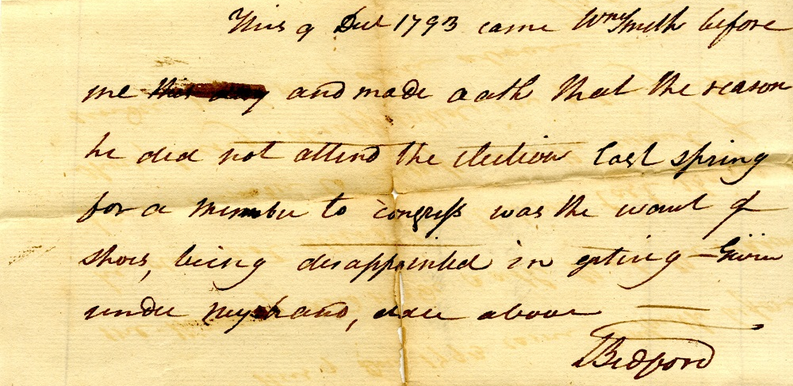
Smith, William. Mecklenburg County (Va.) Election Records: Election Excuses, 1793. Local government records collection, Mecklenburg County Court Records. The Library of Virginia, Richmond, Virginia, 23219.

Slide 16
William Smith
[7]
Mecklenburg
This 9 Dec 1793 came Wm Smith before me this day and made oath that the reason he did not attend the election last spring for a member to congrefs was the want of shoes, being disappointed in getting—Given under my hand, date above—
T. Bedford
Smith, William. Mecklenburg County (Va.) Election Records: Election Excuses, 1793. Local government records collection, Mecklenburg County Court Records. The Library of Virginia, Richmond, Virginia, 23219.

Slide 17
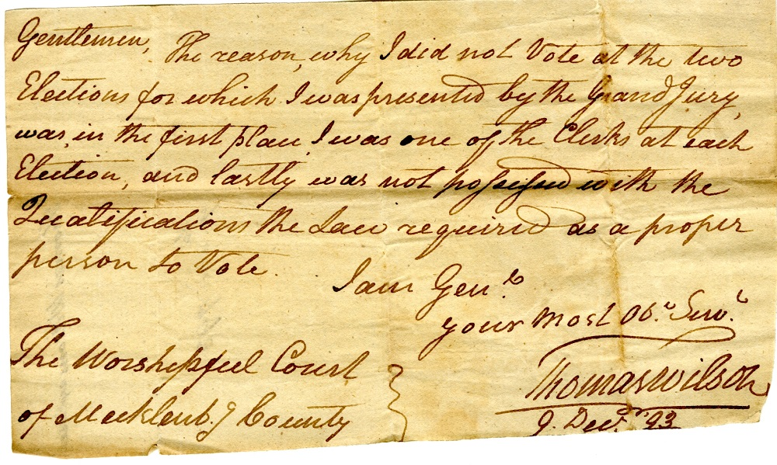
Wilson, Thomas. Mecklenburg County (Va.) Election Records: Election Excuses, 1793. Local government records collection, Mecklenburg County Court Records. The Library of Virginia, Richmond, Virginia, 23219.

Slide 18
Thomas Wilson
[8]
Gentlemen, The reason, why I did not Vote at the two Elections for which I was presented by the Grand Jury, was, in the first place I was one of the Clerks at each election, and lastly was not pofsefsed with the Qualifications the law required as a proper person to Vote.
I am Gen’l.
Your Most Ob’t Serv’t.
The Worshipful Court} Thomas Wilson
of Mecklenb’g County} 9 Dec ‘93
Wilson, Thomas. Mecklenburg County (Va.) Election Records: Election Excuses, 1793. Local government records collection, Mecklenburg County Court Records. The Library of Virginia, Richmond, Virginia, 23219.

Slide 19
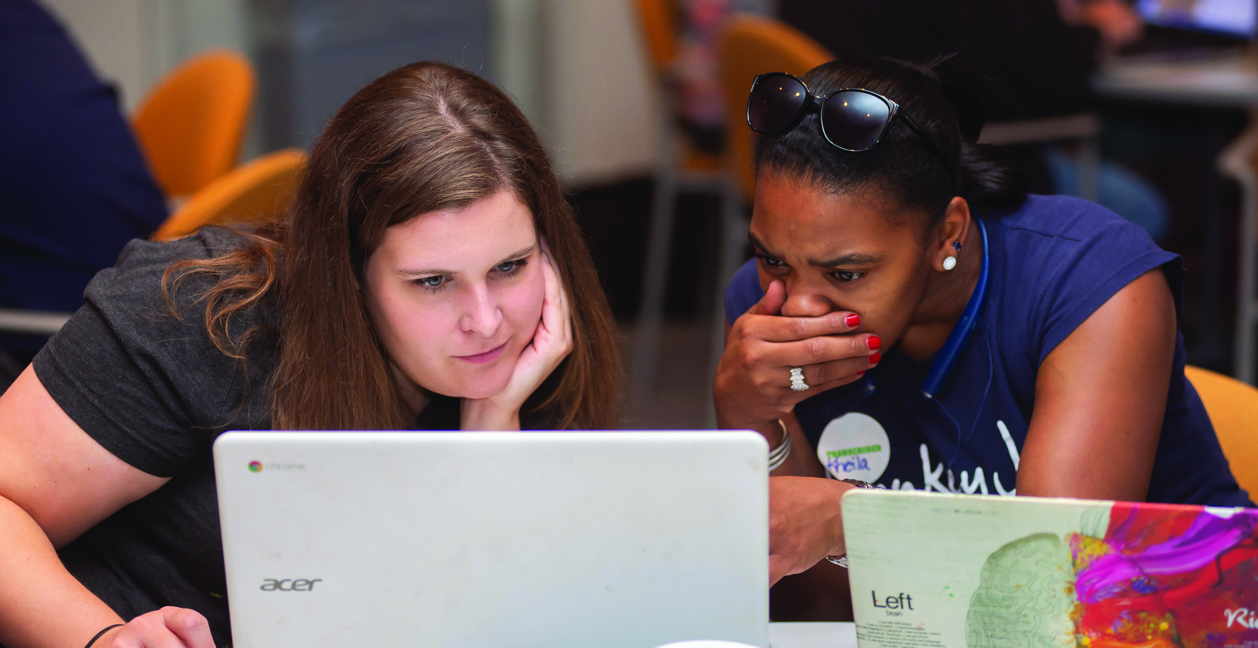
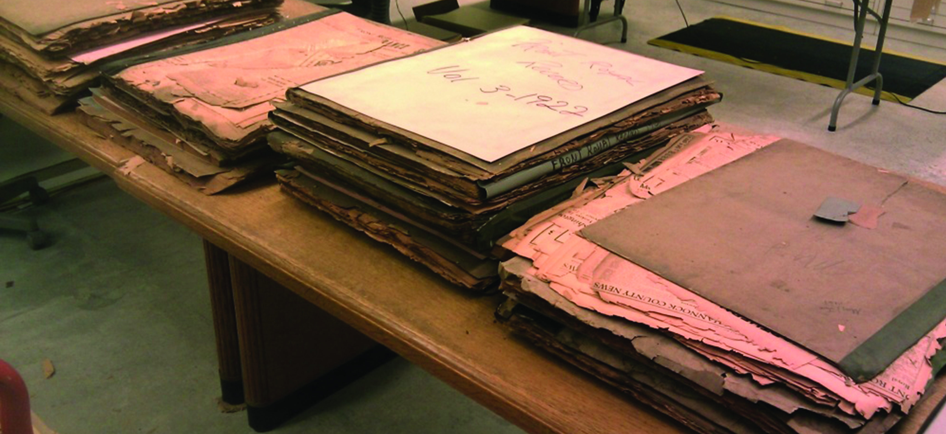
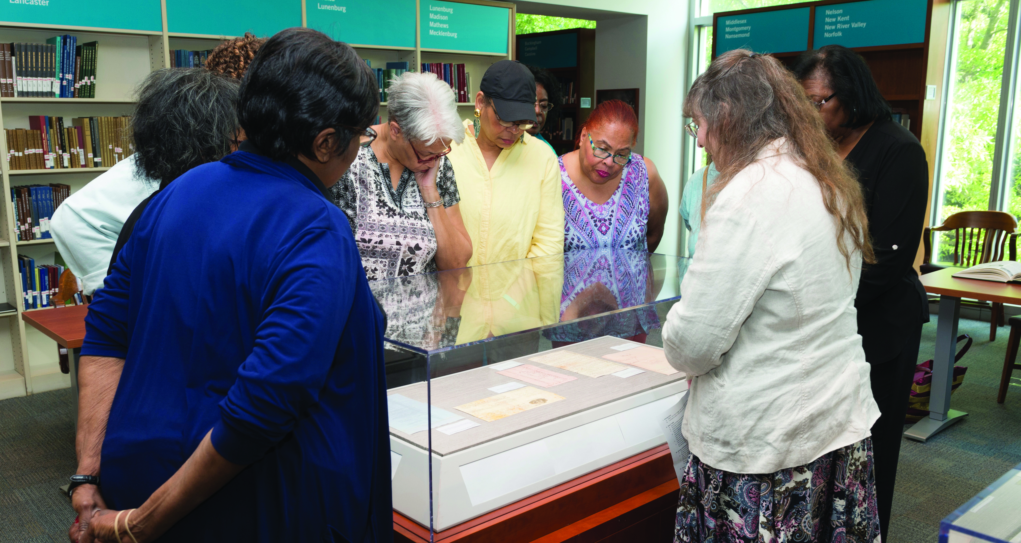
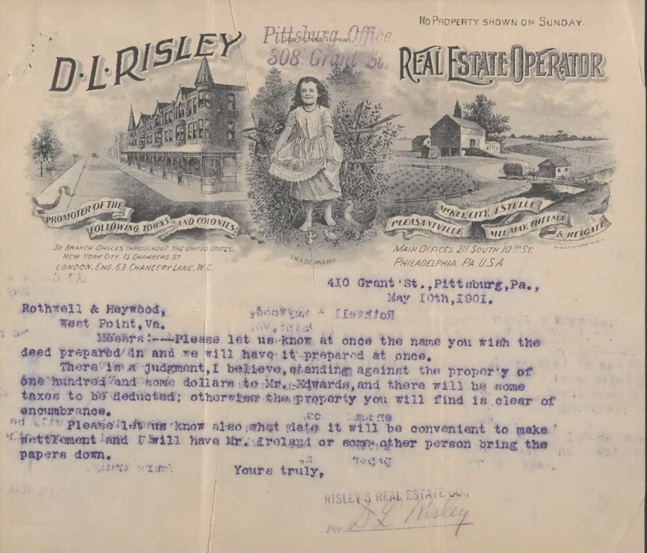
Explore More
LVA Uncommonwealth Blog 10/29/2020: What’s Your Excuse? 1793 Mecklenburg County Election Excuses
  Link to LVA’s collection finding aid
LVA Research Notes #21: Virginia Election Records: Presidential and Congressional Election Returns at the Library of Virginia
  [Link to pdf, if preferred]
Virginia Acts of Assembly 1803, p.19-20, Chap. XVII, “An Act concerning Election of Members of General Assembly.” Passed 12/20/1785.

